Slide 1
Plotting with Bokeh
Interactive plots for user interfacing and web applications

Slide 2
Learning objectives
Create interactive plots using Bokeh
Create dashboards
Visualise the results of models (such as FSF)
Integrate the plots in a web environment

Slide 3
Introduction
Bokeh is a Python interactive visualization library that targets modern web browsers for presentation.
Its goal is to provide elegant, concise construction of novel graphics, and to extend this capability with high-performance interactivity over very large or streaming datasets.
Bokeh can help anyone who would like to quickly and easily create interactive plots, dashboards, and data applications.

Slide 4
Bokeh introduction
To install bokeh use the conda repository
  conda install bokeh
Interactive visualisation
Browser interface at a high level
It is compatible with matplotlib
No JavaScript required!

Slide 5
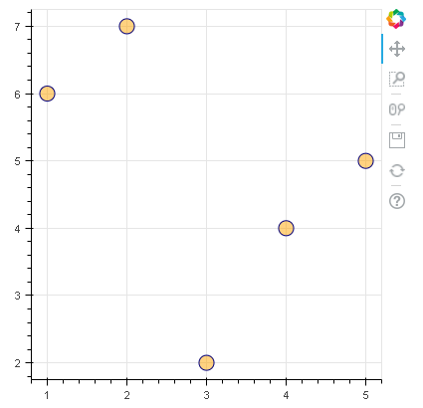
Some definitions
Tools
Figure
(canvas)
Glyphs

Slide 6
Some definitions
Glyphs - The basic visual building blocks of Bokeh plots, e.g. lines, rectangles, squares, wedges, patches, etc. The bokeh.plotting interface provides a convenient way to create plots centered around glyphs.
Models - The lowest-level objects that comprise. Ultimately, all Bokeh plots consist of collections of models, so it is important to understand them enough to configure their attributes and properties.
Widgets - User interface elements outside of a Bokeh plot such as sliders, drop down menus, buttons, etc. Events and updates from widgets can inform additional computations, or cause Bokeh plots to update.
Documents - An organizing data structure for Bokeh applications. Documents contain all the Bokeh Models and data needed to render an interactive visualization or application in the browser.
Application - A Bokeh application is a rendered Bokeh document, running in a browser.

Slide 7
Bokeh outputs
There are various ways to generate output for Bokeh documents. The most common for interactive usage are:
output_file
  For generating simple standalone HTML documents for Bokeh visualizations. These can be later integrated in the browser as static HTML.
output_notebook
  For displaying Bokeh visualizations inline in Jupyter notebook cells. Good for creating and quickly visualising the results of the visualisation
output_server
  Allows the configuration of widgets, and provides back a two-way communication between code and visualisation

Slide 8
Some plotting interactions
Brushing: works by using the mouse to control a paintbrush, directly changing the color or glyph of elements of a plot. The paintbrush is sometimes a pointer and sometimes works by drawing an outline of sorts around points; the outline is sometimes irregularly shaped, like a lasso. Brushing is most commonly used when multiple plots are visible and some linking mechanism exists between the plots.
Identification: which could also be called labeling or label brushing, is another plot manipulation that can be linked. Bringing the cursor near a point or edge in a scatterplot, or a bar in a barchart, causes a label to appear that identifies the plot element. It is widely available in many interactive graphics, and is sometimes called mouseover.
Scaling: maps the data onto the window, and changes in that mapping function help us learn different things from the same plot. Scaling is commonly used to zoom in on crowded regions of a scatterplot, and it can also be used to change the aspect ratio of a plot, to reveal different features of the data.
Linking: connects elements selected in one plot with elements in another plot. The simplest kind of linking, one-to-one, where both plots show different projections of the same data, and a point in one plot corresponds to exactly one point in the other.

Slide 9
Adding interaction to plots in Bokeh
By default, Bokeh has some default tools in a plot.
These tools include zooming, panning and saving.
Additional tools can be added to the figures, and not to the glyphs
Interactions can also occur between the different observations of the

Slide 10
Tools
Bokeh comes with a number of interactive tools. There are five types of tool interactions
  Pan/Drag
  Click/Tap
  Scroll/Pinch
  Actions
  Inspectors
For the first three comprise the category of gesture tools, and only one tool for each gesture can be active at any given time.
Actions are immediate or modal operations that are only activated when their button in the toolbar is pressed.
Inspectors are passive tools that merely report information or annotate the plot in some way, and may always be active regardless of what other tools are currently active.
https://bokeh.pydata.org/en/latest/docs/reference/models/tools.html#

Slide 11
Widgets
Bokeh has several widgets which allows the interaction between plots.
The main type of widgets are:
  Buttons
  Groups
  Inputs
  Panels
  Sliders
  Tables
The widgets only have effect if they are deployed in the server. They do not have effect in plain HTML, as there is no Python background to process the requests

Slide 12

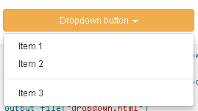


Buttons
Button
  Create to execute a given task
Dropdown
  Allow to select an action from a list
Toggle
  Similar to button, but remains in an on/off state

Slide 13




Groups
Join different widgets together
Checkbox Button Group
  Group of checkboxes as toggle buttons
Checkbox Group
  Group of checkboxes
Radio Button Group
  Group of radio boxes as toggle buttons
Radio Group
  Group of radio boxes

Slide 14
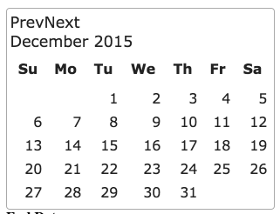

Inputs
Datepicker
  Allows to select a date based on a calendar
Text input
  Allows to send strings to the plot

Slide 15
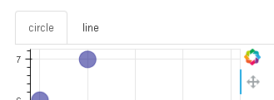
Panels
Panel
  Acts as a container of other plots
Tabs
  A panel with navigation tabs

Slide 16


Sliders
Slider
  Allows to pick a value from a range
Date Slider
  Allows to use the slider to pick a date
Range Slider
  Allows to pick a range
Date Range Slider
  Allows to use the slider to pick a date range

Slide 17
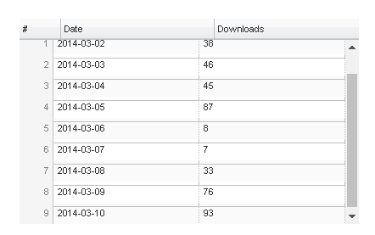
Tables
Data Table
  Large two-dimensional table
  There are plenty of customisation options, regarding the data display.

Slide 18
Now, let’s make the exercise 1
Getting familiar with the basics of plotting

Slide 19
Color Harmony
How to pick a color scheme that will not make your eyes cry

Slide 20
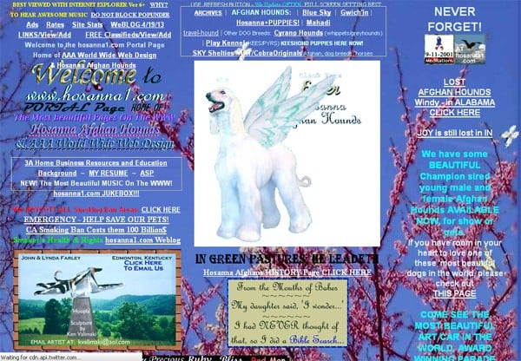
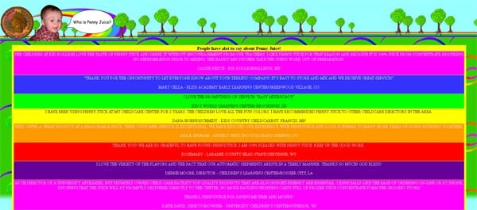
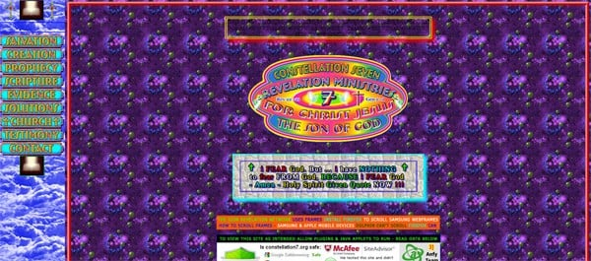
Some examples of what not to do!
Bright blue backgrounds
Too many colours
Bright textured background with color text
https://designwebkit.com/web-and-trends/color-combinations-hell-death-sentence-designs/

Slide 21
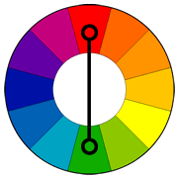
Complementary color scheme
Colors that are opposite each other on the color wheel are considered to be complementary colors (example: red and green).
The high contrast of complementary colors creates a vibrant look especially when used at full saturation. This color scheme must be managed well so it is not jarring.
Complementary color schemes are tricky to use in large doses, but work well when you want something to stand out.
Complementary colors are really bad for text.

Slide 22
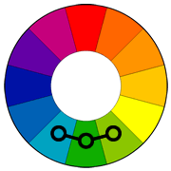
Analogous color scheme
Analogous color schemes use colors that are next to each other on the color wheel. They usually match well and create serene and comfortable designs.
Analogous color schemes are often found in nature and are harmonious and pleasing to the eye.
Make sure you have enough contrast when choosing an analogous color scheme.
Choose one color to dominate, a second to support. The third color is used (along with black, white or gray) as an accent.

Slide 23
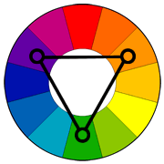
Triadic color scheme
A triadic color scheme uses colors that are evenly spaced around the color wheel.
Triadic color schemes tend to be quite vibrant, even if you use pale or unsaturated versions of your hues.
To use a triadic harmony successfully, the colors should be carefully balanced - let one color dominate and use the two others for accent.

Slide 24
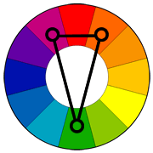
Split-Complementary color scheme
The split-complementary color scheme is a variation of the complementary color scheme. In addition to the base color, it uses the two colors adjacent to its complement.
This color scheme has the same strong visual contrast as the complementary color scheme, but has less tension.
The split-complimentary color scheme is often a good choice for beginners, because it is difficult to mess up.

Slide 25
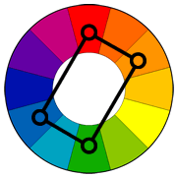
Rectangle (tetradic) color scheme
The rectangle or tetradic color scheme uses four colors arranged into two complementary pairs.
This rich color scheme offers plenty of possibilities for variation.
Tetradic color schemes works best if you let one color be dominant.
You should also pay attention to the balance between warm and cool colors in your design.

Slide 26
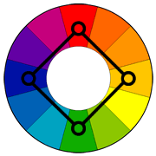
Square color scheme
The square color scheme is similar to the rectangle, but with all four colors spaced evenly around the color circle.
Square color schemes works best if you let one color be dominant.
You should also pay attention to the balance between warm and cool colors in your design.

Slide 27
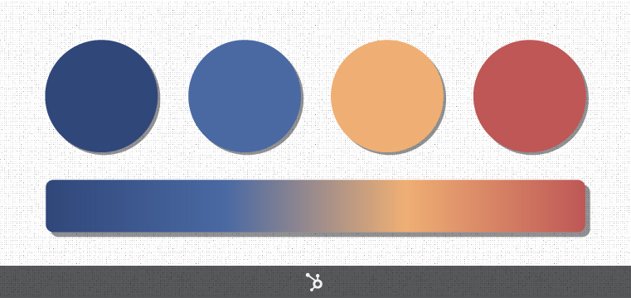

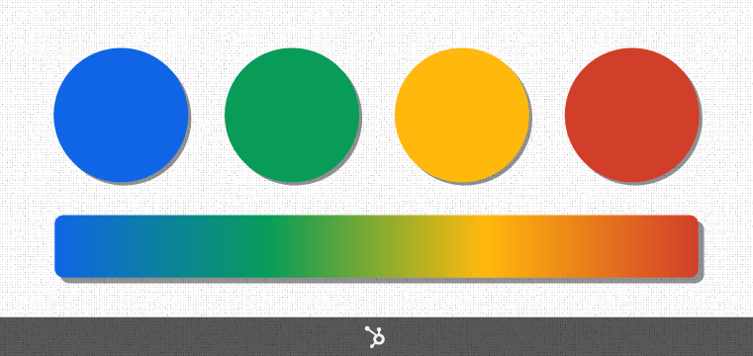
Can you guess the famous palettes?
https://coolors.co/
https://www.sessions.edu/color-calculator/

